Slide 1
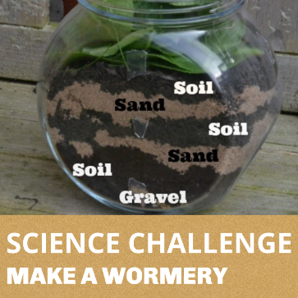
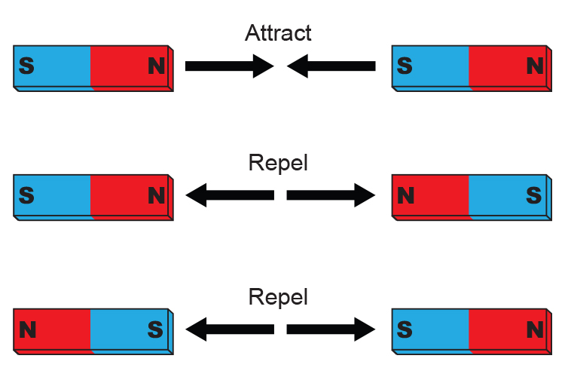
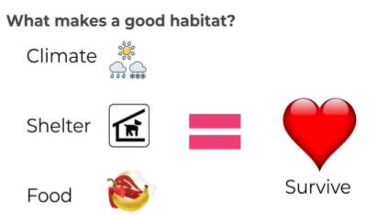
Early Years: Knowledge Organiser: Autumn 1: Let’s Explore
In the Let’s Explore project, your child will explore their class environment and school grounds so that they feel settled and happy in their new surroundings. They will learn about the local environment and find out about places they have visited on holiday. They will look at and create maps for journeys.
How can you learn at home?
Local Community-
Talk about the places you like to visit in your local community. Draw your favourite place Think and talk about why it is your favourite place and what activities you do there.
Use Google Earth to explore the locality.
Drawing a map -
Think of a journey that you make regularly. This could be a journey to school or a trip to the shops. Talk about the places you pass. Draw a map to show the route you take and the places you see along the way.
Senses
Go outside for a walk and use your senses. Make a list of draw pictures of the things your hear, see, smell and touch on your walk.
Share and discuss the Did you know? resource.
Key Books:
What we will find out:
Did you know-
A habitat is a place where living things live. Local habitats include woodlands, gardens and ponds. Other habitats include hot places, such as deserts, and cold places, such as the Arctic.
We will be exploring the force ‘Push and Pull’. We will be exploring which force we use around our learning environment.
Did you know-
Push is a force to move something away.
Pull is a force to move something towards you.
Push and pull are opposite forces, meaning they move objects in
different directions.
Forces are just pushes and pulls in a particular direction.
Possible experiences:
We will be going on a journey around the school. Together we will plan a route that we take us to visit all the classes and outdoor spaces.
Did you know-
Worms help to increase the amount of air and water that filters effectively through the soil. They break down organic matter too and help to create compost that is needed to grow plants.
We will be exploring what ‘ATTRACT’ and ‘REPEL’ means. We will be finding out objects which are magnetic and non magnetic around the environment.
Possible experiences:
We will be making our own wormery.
Possible experiences:
We will be discussing about Harvest being the time of year when farmers bring in their crops before the weather gets too wet or cold. We will learn that people celebrate harvest all over the world.
Possible experiences:
We will talk about animals that we will see in Autumn. We will explore what a habitat is and what makes a good habitat.
Spring | Summer | Autumn | Winter

Slide 2
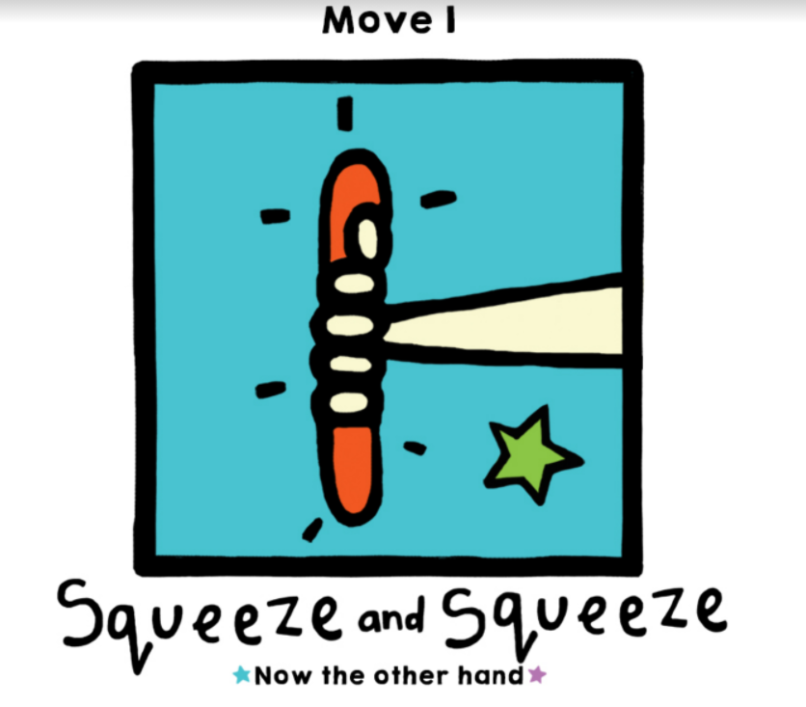
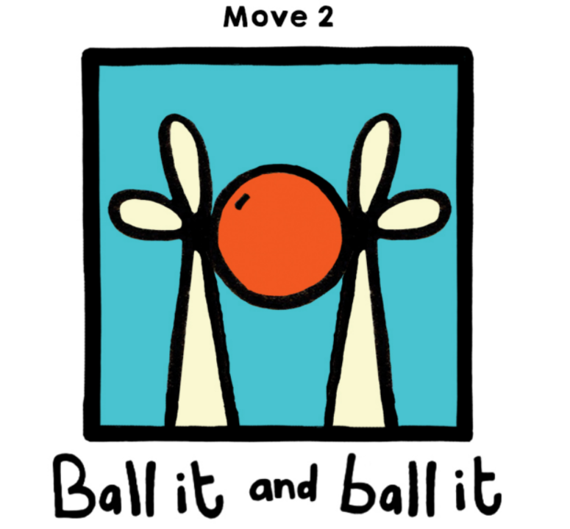
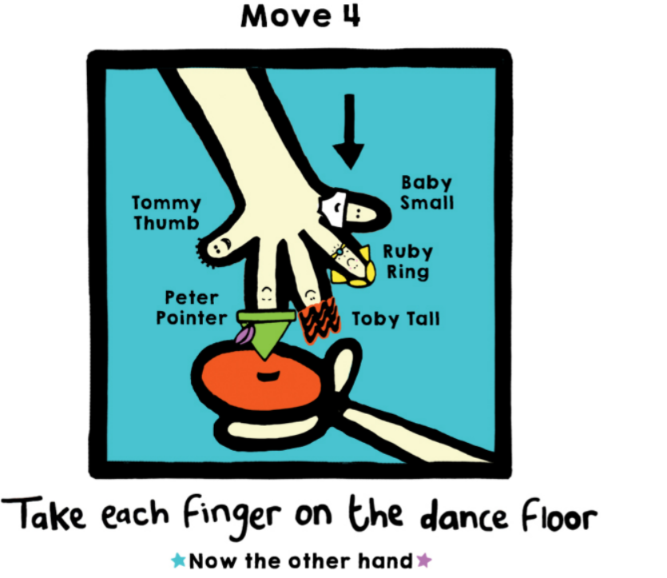
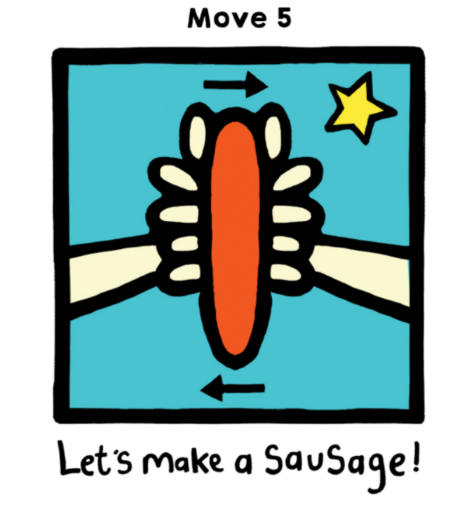
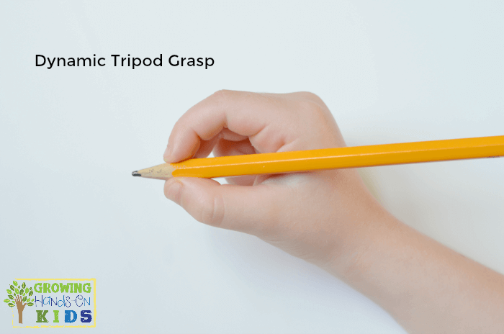
Key Vocabulary:
Possible experiences:
We will be going on a journey around the school. Together we will plan a route that we take us to visit all the classes and outdoor spaces.
Physical Development: Gross and Fine motor Skill
Squiggle Wiggle: Gross and fine motor movement using wavy lines, zig zag lines and arches.
Dough Disco : Fine motor control using dough to practise squeezing, balling the dough, separating each finger to push the dough and also rolling a sausage shape.
Physical Development – Playground Games
We will be playing listening and attention games in PE that will involve the children negotiating the space around them, carefully changing direction etc. Further develop the skills they need to manage the school day successfully: lining up and queuing, mealtimes, personal hygiene.
Expressive Arts and Design: Art /D&T
Painting and drawing focus: using colours for a purpose and specific tools for using lines and circles to represent shapes and objects.
Attaching /modelling- Glue stick, PVA glue, spreaders, sellotape, masking tape.
Joining different media & creating new effects.
Key words: cut, attach, spread.
Tools: scissors, glue spreaders.
Jigsaw (PSED): Puzzle 1- Being me in my World
Piece 4- I understand why it is good to be kind and use gentle hands.
Piece 5- I am starting to understand children’s rights and this means we should all be allowed to learn and play.
Piece 6- I am learning what being responsible means.
.
Mathematics
We are going to be muddling up several pairs of socks and asking the children to sort them into pairs. We will be talking about the colours, patterns and sizes of the socks. We will be asking if there is a partner for every sock, or is it an odd one?
We will be using blocks to build towers that match. Can the children build towers of a matching height? Do they look exactly the same?
Songs / Rhymes
When tidying or playing at home practise counting toys, knives and forks for the dinner table, shoes, scoops when cooking etc
Seasons of the Year
Literacy: Writing: We will be working on pencil grip, ensuring
correct formation of letters in our name and giving meaning
to our marks and symbols.
At home can you go on a sound walk? Listen for different sounds in the environment and talk about what you can hear.
Partially fill opaque plastic bottles or socks with noisy materials (eg. Rice, peas, marbles, coins) Ask your child to shake the bottles or socks and identify what is inside from the sound the items make.
Tripod pencil grip
Can you build a tower taller than you?
Can you build a bridge for your cars? How wide and high does it need to be?
At home practise writing your name. Please ensure your child is using the correct pencil grip (Tripod pencil grip).

