Slide 1
Early Years: Knowledge Organiser: Spring 1: Long Ago
How can you learn at home?
Activity 1-
Look at photographs from when you were a baby and talk about the changes that have happened.
Activity 2-
Memories are things that we remember from the past. Talk about some of your special memories, then draw and write about them.
Activity 3-
We use words like first, then and next to order events and show the passing of time. Draw pictures or write simple sentences to show the order you do things when getting ready for school in the morning.
Activity 4-
Look at family photographs and talk about who is in the photographs and how you are related. Draw and label your family
Activity 5-
Talk to your grandparents about their past. You could ask about where they lived, what games they played, who their friends were and what their school day was like.
Key Book for this term:
What we will find out:
Explore these words together. Talk with an adult about what each word means and use the words in a sentence or as you play.
Possible Experiences:
Explore how weather changes throughout the year.
Talk about the past, present and future.
Order pictures to create visual timetable for a school day.
Explore past and present toys.
Find out why pictures were black and white in the past.
Explore past and present clothes. We will find out how they washed their clothes in the past.
We will find out what Historians and Archaeologists are and what they do.
Explore how school was different in the past.
Spring | Summer | Autumn | Winter

Slide 2
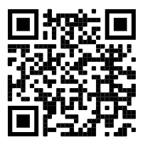
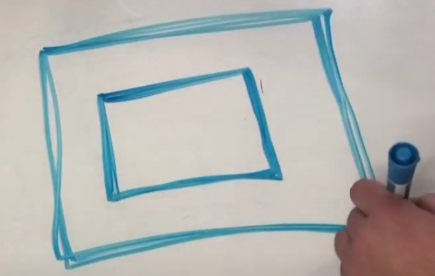
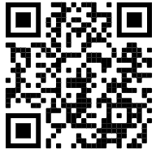
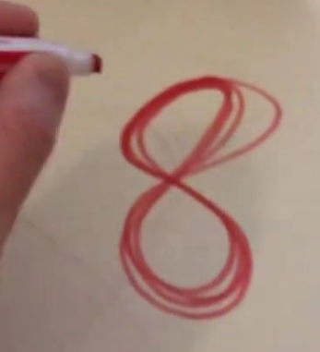
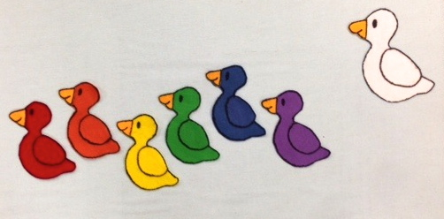
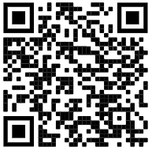
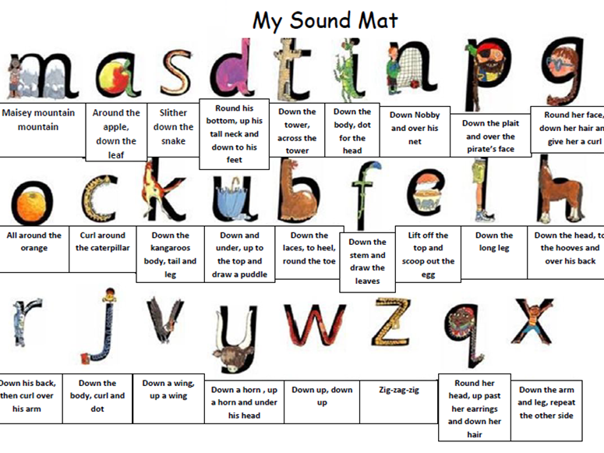
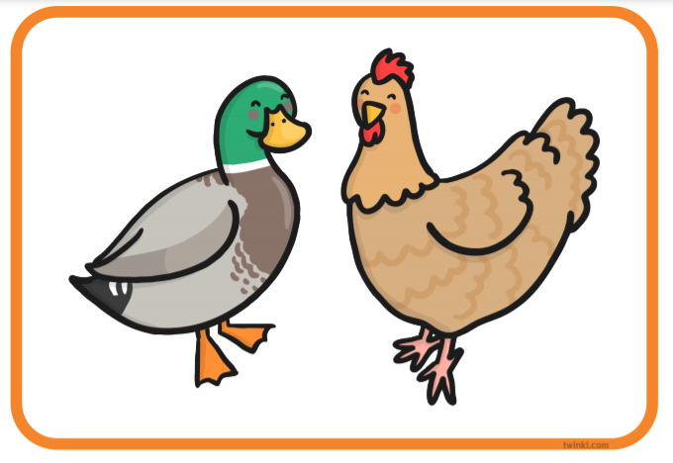
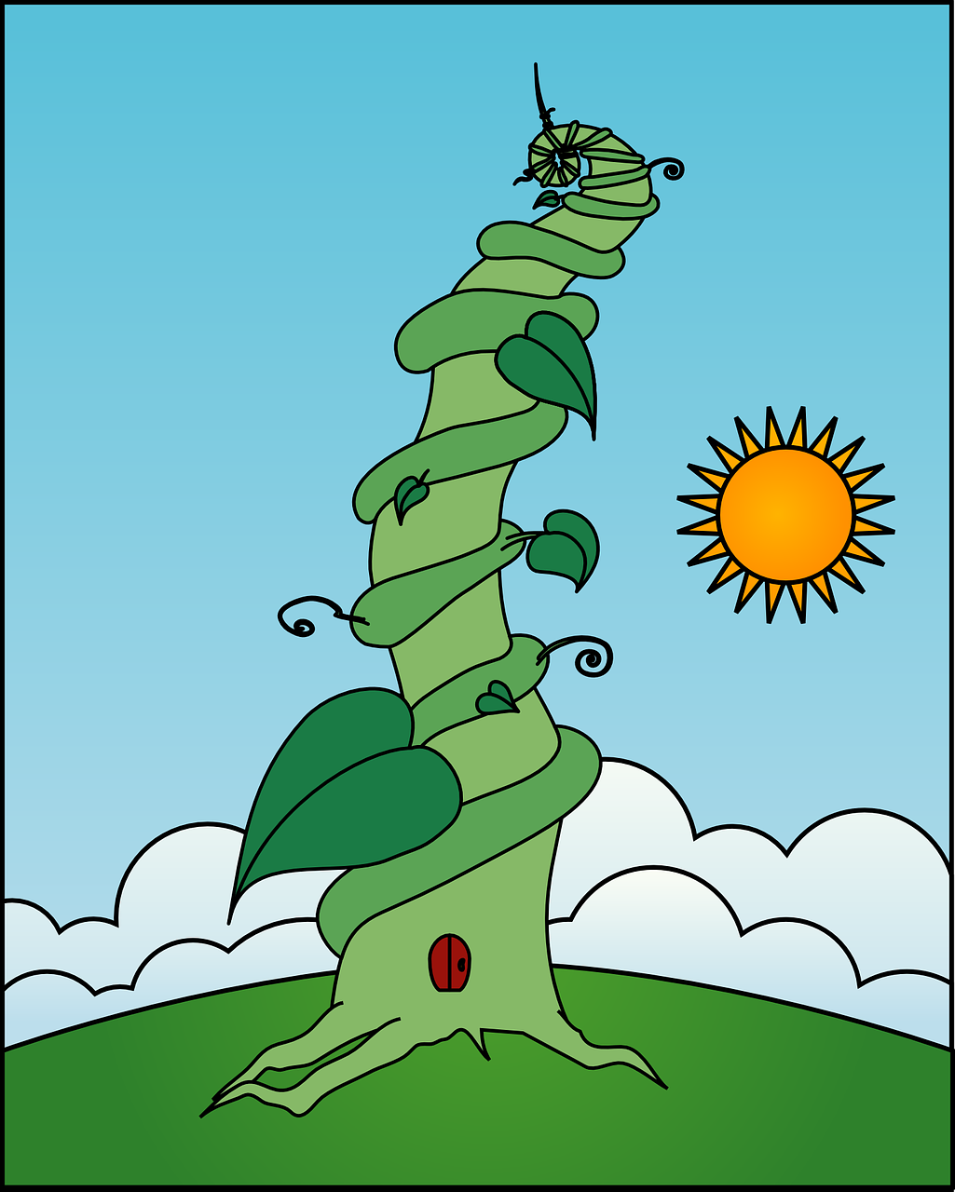
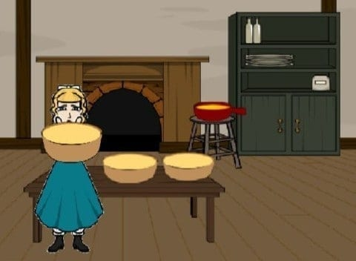
Physical Development: Gross and Fine motor Skill
Gross and fine motor movement: Scan to practise at home.
Physical Development - Gym - rolls, jump, skip, hop, climb, crawl, balance, run.
Expressive Arts and Design:
Sculpture- We will explore that in the past, people only had paintings and sculptures to show what people looked like and kept their images alive. Artists had the job of creating these works of art. We will use clay to roll it, make shapes and draw in it to make a clay tile of our face. We will stick bits of clay on to show our facial features or will we draw into the clay.
Square pattern.
Figure of 8.
Understanding the World: People, Culture and communities
Sing lots of number rhymes with your children at home to develop counting skills.
Watch the Jack Hartman numbers to 100 song on You Tube. We always warm up with this song during our Maths Meeting.
We will share our ideas about things we would like to achieve this year.
Scan this code to find out more information about Chinese New Year.
In Maths, we will be conducting surveys with our friends and finding out that we can make marks to represent numbers. We will also be
counting accurately to find out how many objects are in a group.
The Greatest Showman Body percussion.- Scan the QR code and make repeated rhythms by copying the pictures.
Jigsaw (PSED): Puzzle 3- Dreams and Goals
Piece 1- I understand that if I persevere I can tackle challenges.
Piece 2- I can tell you about a time I didn’t give up until I achieved my goal.
Piece 3- I can set a goal and work towards it.
Did you know:
Sound patterns can be made by repeatedly clapping or tapping the same sounds. This is called a rhythm.
Literacy: Reading
We will be finding out about different
characters in stories and talking about
Some of our favourite characters. We
Will be drawing them and talking about
Why we like them. We will also be
talking about different settings in
stories, and identifying different settings
in the books that we read at Nursery.
Do you know which story
each setting is from?
Set 1 sounds.
Literacy
We will be painting pictures of Goldilocks and labelling them, listening out for initial sounds as well as middle and end sounds.
Younger children will be drawing pictures and talking about what they drawn, giving meaning to the marks they have made.
At home, pour flour or salt onto a tray
and make marks with your child.
They could write the first letter of their name, or draw zig zags and squiggles.
Older children, see if you can think of objects that begin with the sounds we have been learning. These sounds are:
m,a, s, d, t, i, n, p, g
.
Literacy: Writing
Orally compose a caption and hold it in memory before attempting to write it with support.
Orally compose (say) a caption.
Tap, clap, stomp the caption.
Count how many words.
Say first word / Fred talk the word / write the word.
A duck and a hen.
Write from left to right and top to bottom. Begin to form recognisable letters.
These are the rhymes that Nursery children are learning with their letter sounds.
Can you draw a picture and write a simple caption?

