Slide 1
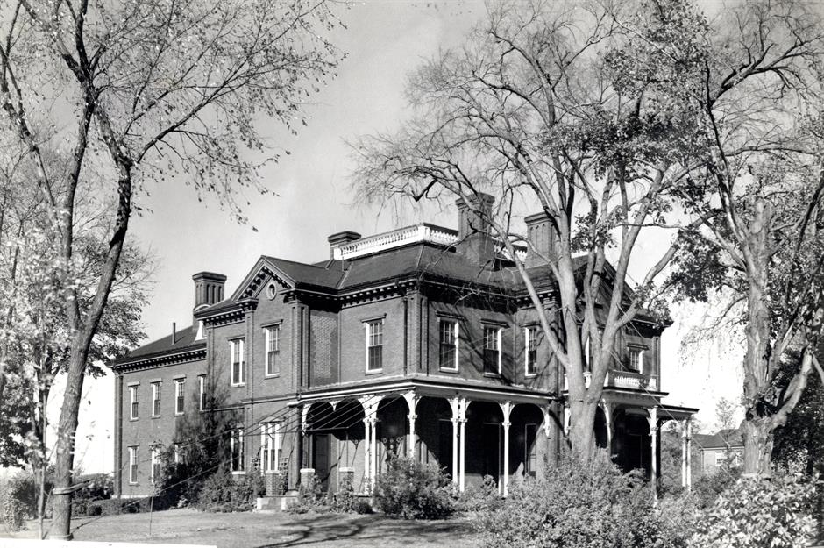
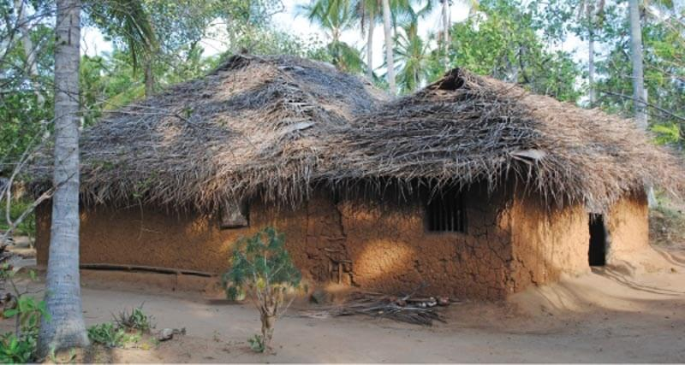
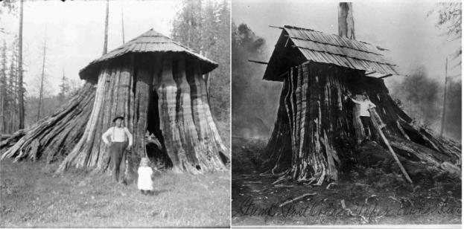
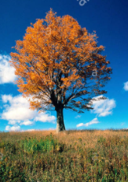
Early Years: Knowledge Organiser: Autumn 2: Build it up!
Possible experiences:
We will look at pictures of unusual buildings from around the world, then design our own unusual building.
How can you learn at home?
Local Area -
Go for a walk around the local area and look for different types of homes. Can you talk about the similarities and differences?
Your home -
Draw a picture of the front of your home and label its features e.g. door, window, bricks etc.
Model-
Make a model of your home. You could use lego, wooden bricks or cardboard boxes.
The Three Little Pigs –
Share the story ‘The Three Little Pigs’. Draw a picture of each of the three houses that the pigs made.
Investigation-
Carry out an investigation to find out about waterproof materials. Put a piece of kitchen roll over the top of a cup and secure with an elastic band. Carefully pour a teaspoon of water onto the kitchen roll and see what happens. Repeat with other materials, such as paper, card, cling film, fabric and tin foil. Record your results in the table.
Key Books for this half term:
In the Build It Up project, your child will explore structures in the world around them. They will learn about materials and their properties, and will have the chance to work independently and in groups to design and make marvellous structures.
Did you know:
An architect is someone who designs buildings.
What we will find out:
Possible experiences:
Exploring different types of houses including detached, bungalows, flat, caravans, cottages etc.
Exploring materials and using the vocabulary weak, flexible, strong, soft, hard etc.
Designing and building a house and bridge.
Possible experiences:
We will be comparing homes from the past and how they have changed. We will be exploring similarities and differences.
Possible experiences:
Builders use tools to help them with different jobs. We will look at these tools and find out how a builder would use them.
Spring | Summer | Autumn | Winter

Slide 2
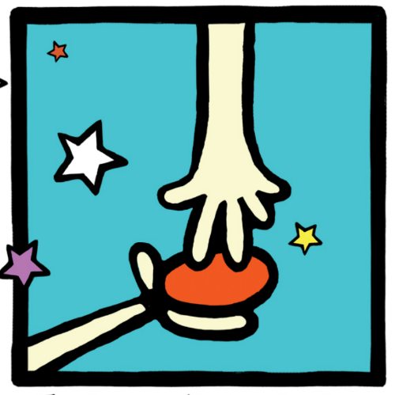
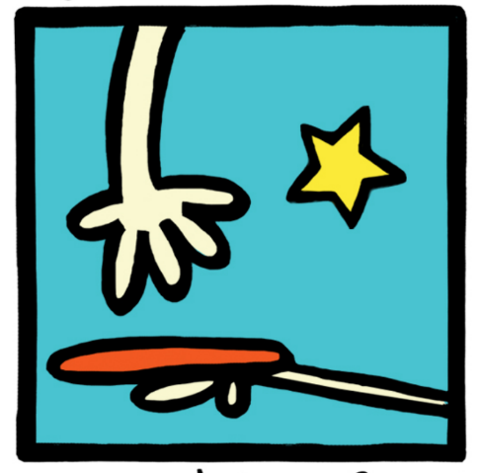
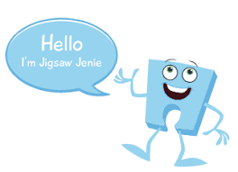
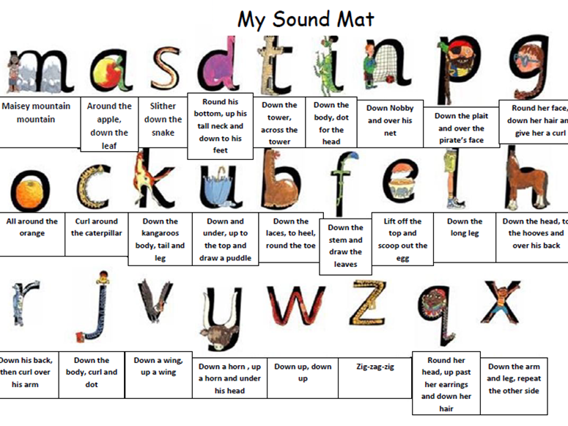
Possible experiences:
Explore these words together. Talk with an adult about what each word means and use the words in a sentence or as you play.
Physical Development: Gross and Fine motor Skill
Squiggle Wiggle: Gross and fine motor movement using circles, arches and spirals.
Dough Disco : Fine motor control using dough to practise two finger disco, piano fingers and pinching the dough into a pizza.
Physical Development – Playground/ Parachute Games
We will be playing listening and attention games in PE that will involve the children negotiating the space around them, carefully changing direction etc. Further develop the skills they need to manage the school day successfully: lining up and queuing, mealtimes, personal hygiene.
Can you make playdough at home following the recipe / instructions?
Expressive Arts and Design: Art /D&T
Attaching /modelling- Glue stick, PVA glue, spreaders, sellotape, masking tape.
Joining different media & creating new effects.
Key words: cut, attach, spread.
Tools: scissors, glue spreaders.
Experiences may include:
Creating using a range of 3D shape recycling materials and block play (flat)
Music:
I can sing songs, which contain a small range of notes (2 or 3 notes for example).
I can perform actions to accompany songs. (Move like a snake etc)
Mathematics
Loose Parts – We will be sorting out groups of objects such as lids, buttons and cotton reels. Children will be exploring the resources and sorting them into groups. How can we sort the groups?
Odd one out – We will be looking at sets of objects and spotting the odd one out. Eg: 3 pinecones and 1 acorn. 3 circles and one square. Which is the odd one out? Which doesn’t belong?
We will continue to do our daily Maths Meetings, concentrating on reciting our numbers to 10 and beyond!
We will also be creating simple patterns using 2 colours. The children will chant the pattern as we create it and then attempt to make a pattern independently. We will also be tracing pattern cards and printing patterns using fruit.
Jigsaw (PSED): Puzzle 2- Celebrating Differences
Piece 1- I can identify something I am good at and understand that everyone is good at different things.
Piece 2- I understand that being different makes us all special.
Piece 3- I know we are all different but the same in some ways.
Literacy: Reading and Writing
Phonics
We will be including rhyming books as part
of our story session and encouraging the
children to identify the rhymes and join in
with repetitive phrases.
w
We will be learning the sounds (phonemes) for each letter of the alphabet.
This half term, we will be looking at the letters m, a, s, t and d, and talking about the objects that begin with those sounds.
We will be singing lots of songs and action rhymes, as this will help the children to develop a wide repertoire of songs and rhymes. Children will have to add claps, knee pats and foot stamps and listen out for changes in the phrases or beat to know when to change their actions.
Scan the QR code to take you to a teddy bear maths game. Can you practise counting objects up to 10.
Can you say some rhyming words with your child and see if your child can join in? Get them to think up a funny rhyme for their name. It doesn’t have to make sense. Just have some fun!
Can you draw pictures of your favourite toys and talk about what you have drawn? Can you hear what sound your toy begins with? This is a tricky challenge!

