Slide 1
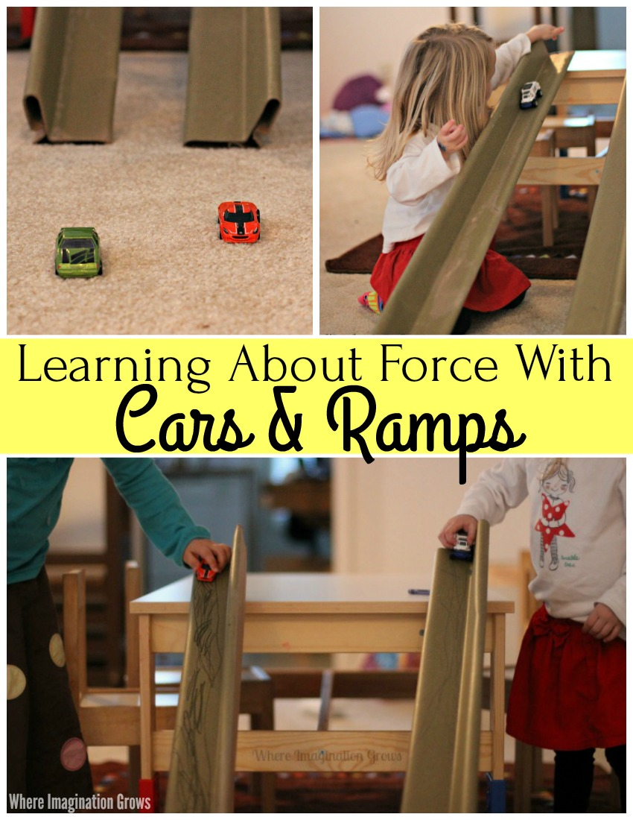
Early Years: Knowledge Organiser: Autumn 2: Marvellous Machines
How can you learn at home?
Activity 1 -
Think about the machines you use every day and how they help you. Imagine that you could design a machine to do a job. What job would you like your machine to do and how would you like it to look? Design and label your machine.
Activity 2 -
Some materials are magnetic, which means that they are pulled towards (attracted to) a magnet. Use a magnet to find magnetic and non-magnetic materials and objects in your home and list them
Activity 3-
Machines need to be powered by electricity. Batteries are a source of electric power. Find, then list or draw, machines and toys that use batteries.
Activity 4 –
Go on a machine hunt around your home. Draw pictures of all the machines you find.
Key Book for this half term:
What we will find out:
Possible experiences:
We will be exploring modern and old machines. We will talk about the machines, compare them and describe how they have changed and developed over time.
Did you know:
Vehicles and machines have wheels and axles to help them move.
Possible experiences:
We will be exploring modern and old transport. We will talk about the different types of transport, compare them and describe how they have changed and developed over time.
Possible experiences:
We will be learning about the force ‘push’. We will be investigating to see how much force is needed to send different sized vehicles down the ramp. We will predict which vehicle will travel the furthest and why.
Possible experiences:
We will discussing how vehicles move. We will sort the different vehicles into wheels and no wheels.
Spring | Summer | Autumn | Winter

Slide 2
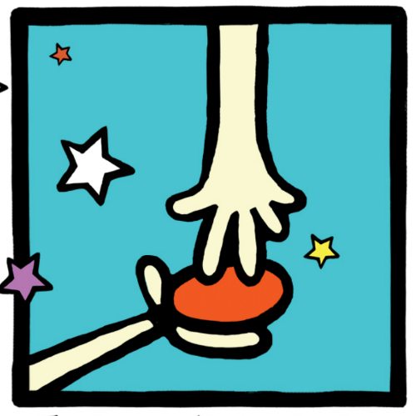
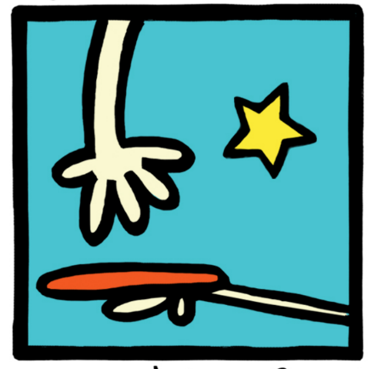
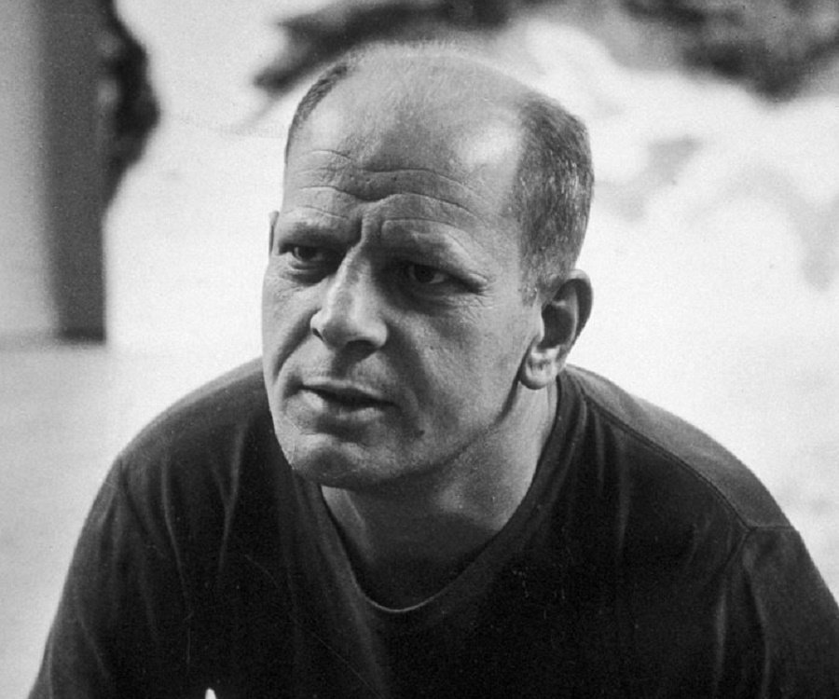
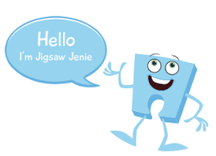
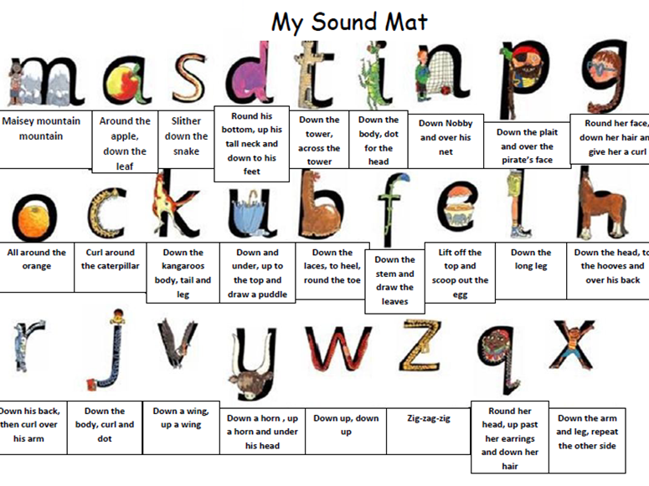
Possible experiences:
Explore these words together. Talk with an adult about what each word means and use the words in a sentence or as you play.
Physical Development: Gross and Fine motor Skill
Squiggle Wiggle: Gross and fine motor movement using circles, arches and spirals.
Dough Disco : Fine motor control using dough to practise two finger disco, piano fingers and pinching the dough into a pizza.
Physical Development – Playground/ Parachute Games
We will be playing listening and attention games in PE that will involve the children negotiating the space around them, carefully changing direction etc. Further develop the skills they need to manage the school day successfully: lining up and queuing, mealtimes, personal hygiene.
Can you make playdough at home following the recipe / instructions?
Possible experiences:
We will be learning all about electricity. We will be making our own simple circuit and investigating what happens when there is a break in the circuit or if the battery is removed.
Expressive Arts and Design: Art /D&T
Making a healthy snack using a machine e.g. smoothie using a blender or toast using a toaster.
Painting: Jackson Pollock
He was an abstract artist which means he used shapes and colours rather than painting real things
Pollock invented ‘paint dripping’. He used different tools to drip, pour and splatter paint onto the canvas from above.
Maths: We will continue to create simple patterns using 2 and sometimes 3 colours. We will be comparing size and learning that objects can be compared and ordered according to their size.
At home: Encourage language such as big, little, small and large to describe a range of objects.
Encourage your child to touch count objects using their finger. Can they count objects to 5 and beyond?
Place objects in different arrangements rather than a straight line, and see if your child can count a small group accurately. This is a tricky challenge!
Scan the QR code to take you to a teddy
Bear maths game. Can you practise counting
objects up to 10?
Jigsaw (PSED): Puzzle 2- Celebrating Differences
Piece 4- I can tell you why I think my home is special to me
Piece 5- I can tell you how to be a kind friend.
Piece 6- I know which words to use to stand up for myself when someone says or does something unkind.
Literacy: Reading and Writing
Phonics
At home
We have been learning the sounds ‘d’ and ‘t’. We are learning the rhymes that go with the sounds to help us when we start to write.
d-d-d- dinosaur
Round his bottom, up his tall neck, down to his feet.
t-t-t- tower.
Down the tower, across the tower.
Continue to sing songs and action rhymes with your child, as this is a vital introduction to early reading and will help them to develop a wide repertoire of songs and rhymes. Add body percussion sounds to nursery rhymes, performing the sounds in time to the beat. Change the body sound with each musical phrase or sentence.
We will be labelling pictures and models by writing the initial sound and then any other sounds we can hear.

