Slide 1
Early Years: Knowledge Organiser: Spring 1: Puppets and Pop Ups
How can you learn at home?
Activity 1 –
Watch a puppet show or episode of The Furchester Hotel on BBC iPlayer. Talk about how the puppets move and talk. Draw your favourite puppet and write the name of it.
Activity 2-
Can you make a paper plate puppet like to ones below.
Activity 3-
Look at these pictures of shadow puppets. Make stick puppets from card and lollipop sticks, then use them to make shadow puppets. Can you take pictures of your shadow puppets and bring them into school to show the rest of the class?
Key Book for this half term:
Explore these words together. Talk with an adult about what each word means and use the words in a sentence or as you play.
What we will find out:
Scan the QR code to follow the instructions to make your own Shadow Puppet Theatre.
Spring | Summer | Autumn | Winter

Slide 2
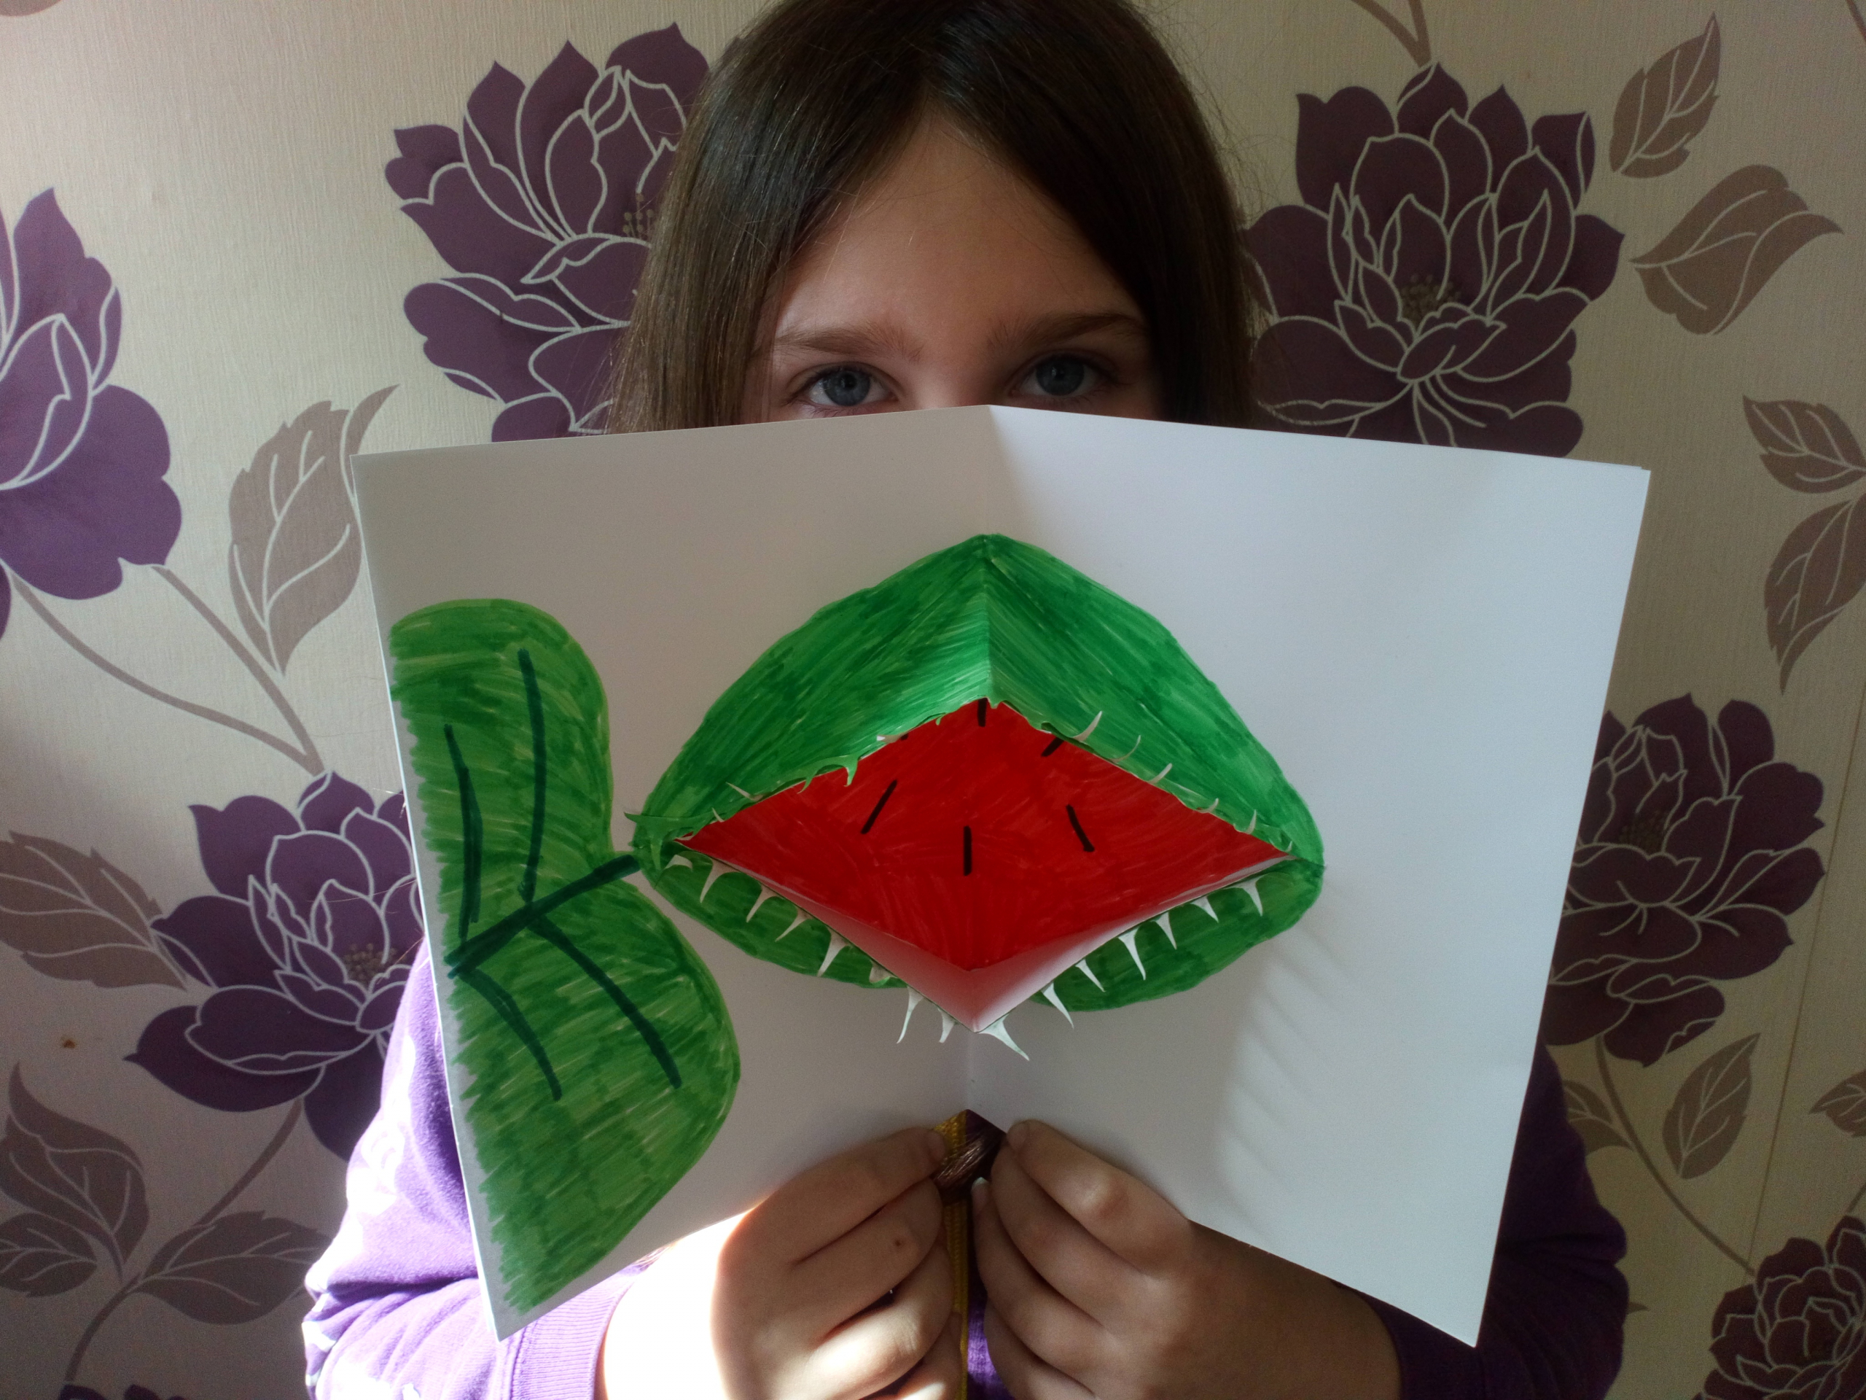
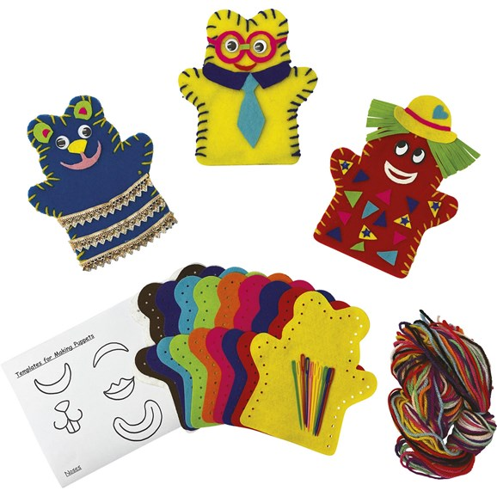
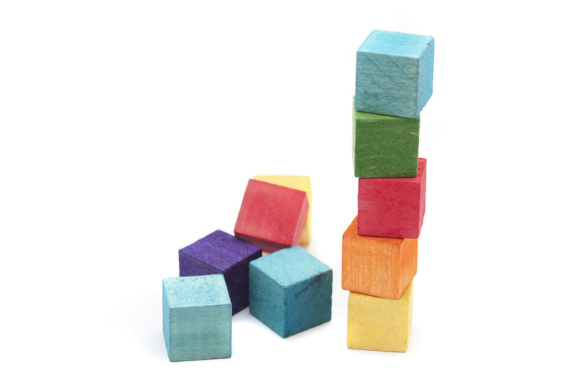
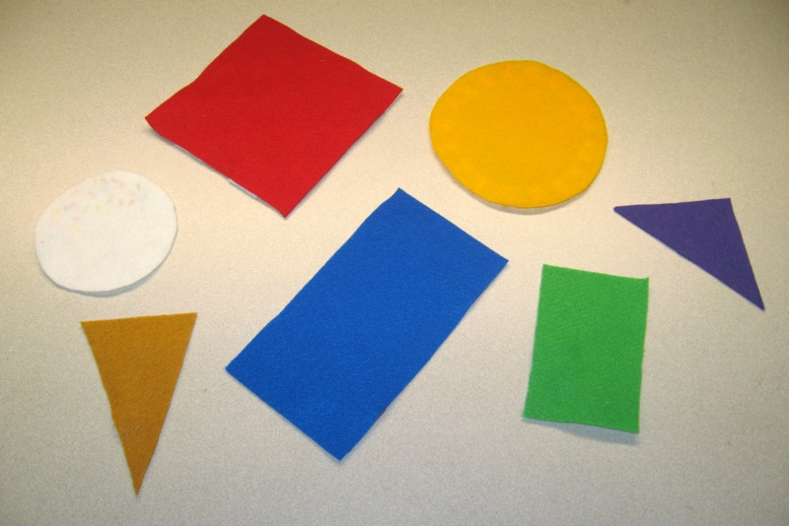
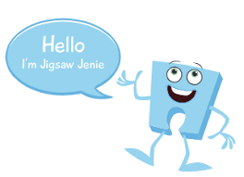
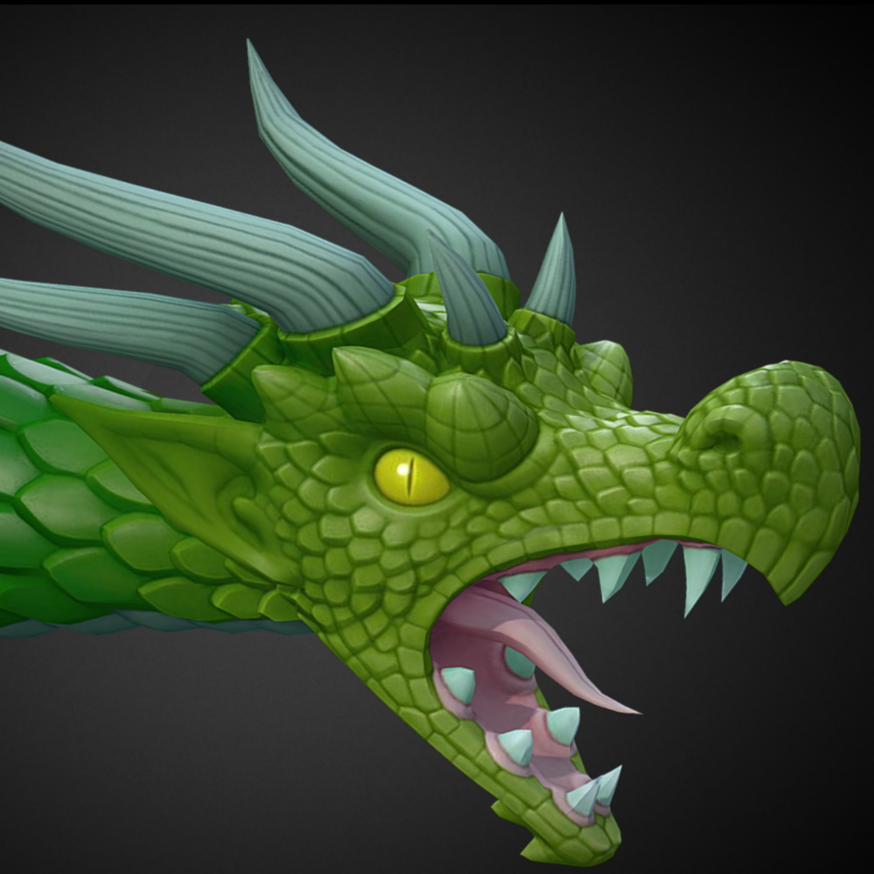
Physical Development: Gross and Fine motor Skill
Gross and fine motor movement.
Physical Development (Focus for outdoor play): Ball skills and games
I can throw underarm, throw an object at a target and catch using two hands. I can bounce and kick a ball and use equipment to control a ball.
What happens to our bodies when we exercise? We breathe more quickly, our heart beats faster and we get hotter.
Physical Development- PE - Gymnastics - rolls, jump, skip, hop, climb, crawl, balance, run.
Expressive Arts and Design:
Making a moving part puppet-
We will cut out body parts and join them together using split pins and straws so that the puppet can be moved.
Creating a pop up picture-
Sew using a needle and thread-
We will be learning how to sew a puppet together by threading the needle in and out of the fabric.
Diagonal lines
Join in with the song ‘Five Little Men in a Flying Saucer’ with your child. Do they know what numbers come next in the song?
In Maths, we will be counting accurately to find out how many objects are in a group. We will also be counting objects in different arrangements and recognising that the final number is the total amount. We will also be conducting surveys with our friends, and finding out information by making marks to represent lower numbers.
The Greatest Showman Body percussion.- Scan the QR code and make repeated rhythms by copying the pictures.
Oak National Academy- Grouping and Sharing
Can you join in with our shape song? We sing this every morning in our Maths meeting. https://www.youtube.com/watch?v=svrkthG2950 Name the shape game – Jack Hartman
Jigsaw (PSED): Puzzle 3- Dreams and Goals
Piece 4- I can use kind words to encourage people.
Piece 5- I understand the link between what I learn now and the job I might like to do when I’m older.
Piece 6- I can say how I feel when I achieve my goal and know what it means to feel proud.
Did you know:
Sound patterns can be made by repeatedly clapping or tapping the same sounds. This is called a rhythm.
Literacy: Reading
We will be continuing to talk about different characters in stories and the reasons that we like them. We will be looking at photographs of different objects and animals and describing them using full sentences and ‘suave’ vocabulary. eg: “The dragon looks
ferocious.” At home, encourage your children to describe objects or
pictures using vocabulary that they wouldn’t normally use. Think of
some alternative words to use instead of ‘happy’, ‘sad’, or ‘scary.’
We will be reading the story ‘Peace at Last’, and talking about the
sequence of events, and learning to re tell the story using puppets
and masks.
As well as this, we will be continuing to learn set one sounds. Our
new sounds will be : u, b, f, e, l, h, r, j
Literacy: Writing
We will continue to encourage children to make marks and talk about what they have drawn/written. Older children will be using their phonics knowledge to label pictures and write shopping lists. You could write a shopping list with your child at home, asking them to listen out for sounds in words, especially beginning and end sounds.
.

